Slide 1
Building a successful future through information and digital literacy
Dr Gillian Hallam
Manager, Information and Digital Literacy
UQL Cyberschool Seminar 2017
24 July 2017

Slide 2
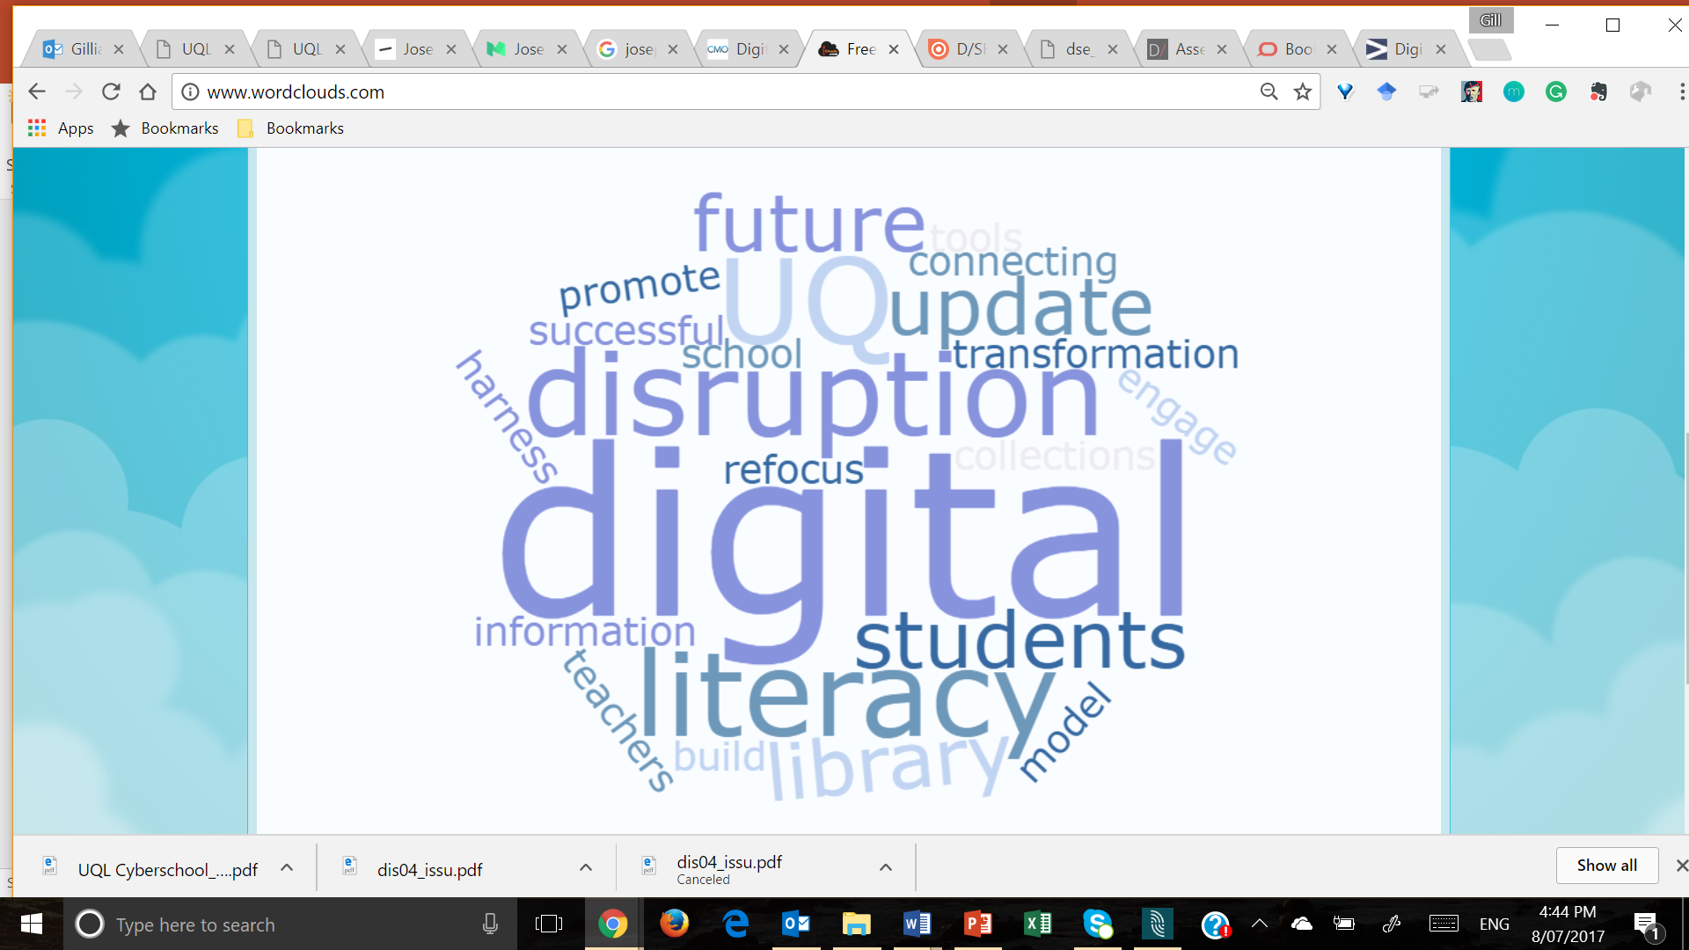
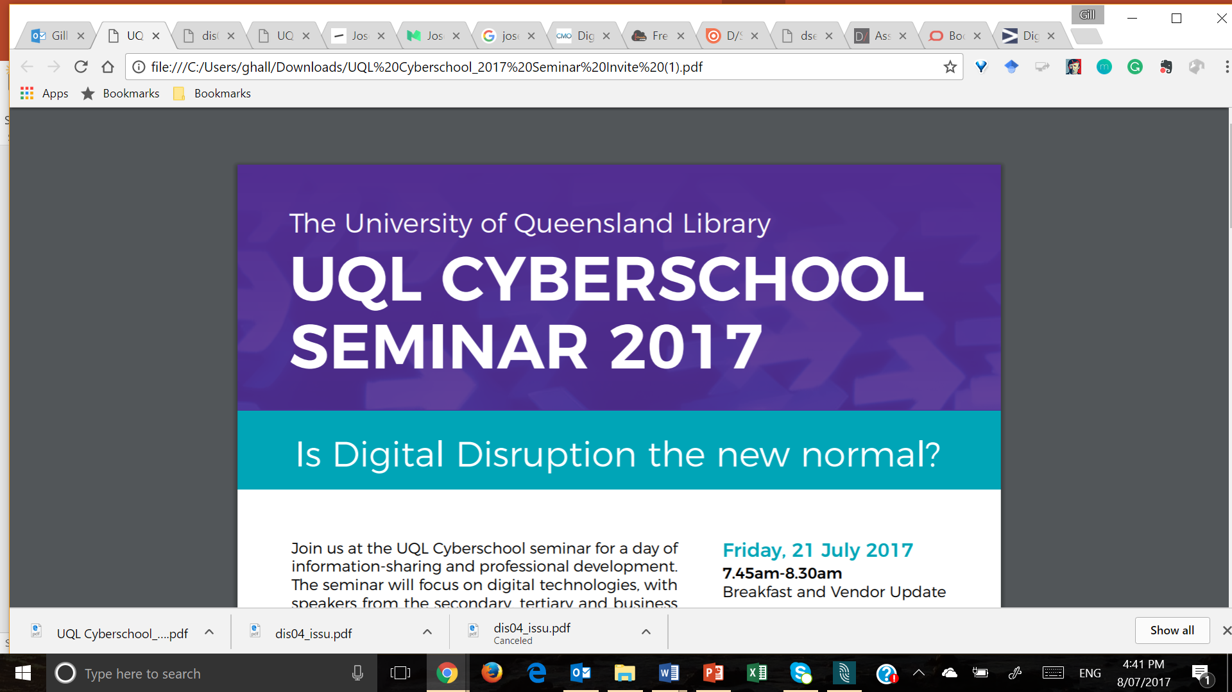

Slide 3
Overview
What do we mean by ‘digital disruption’?
What might this mean to the future workforce?
Where does digital literacy fit in?
  What do we actually understand as ‘digital literacy’?
What is happening at UQ?
  The UQ Student Strategy
What is happening in UQ Library?
  UQL Strategic Framework for Information and Digital Literacy
How can we all work together to build a successful future?

Slide 4

So - what are your views?
Do you think ‘digital disruption’ is:
Good
Bad
Fake news?
Image: http://vr-rendez-vous.up.seesaa.net

Slide 5
What do we actually mean by ‘digital disruption’?
“ | Digital disruption refers to the rapid, transformational change made possible by digital technologies and the impact they have on existing business practices, challenging and, in some cases threatening, the established way of doing business. (Kelly & Schaufenbuel, 2016, p.4)

Slide 6
Arguably, there is nothing new here – new technologies have always emerged to replace old technologies…
The printing press, electricity, the horseless carriage, flight…
However, two significant factors:
  The speed of change
  The high stakes involved
Technological change is exponential
The rate of change is always accelerating
Innovation is happening on multiple fronts simultaneously
Many new digital technologies are converging
“to enable new and unexpected opportunities”

Slide 7
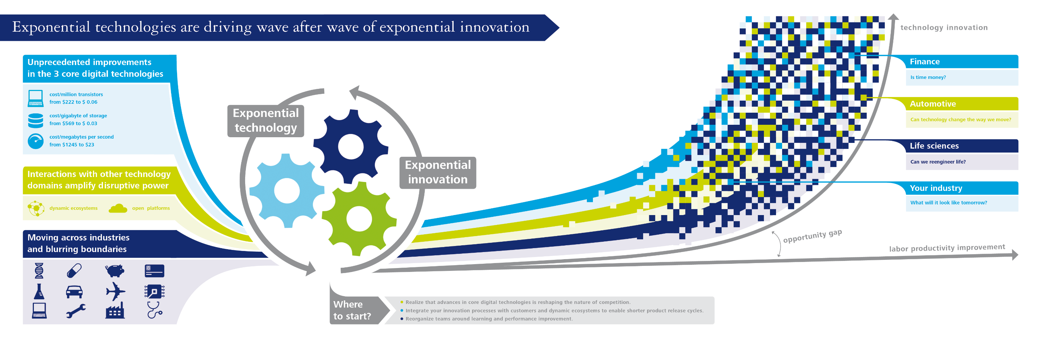

Computing power
Digital storage
Bandwidth
Image: Deloitte University Press

Slide 8
Interpretations of disruption can vary…
“Disruptive innovation”: new ideas and technologies can be deliberately employed to:
  Upset the status quo
  Redefine industry best practice
  Change the very rules of the game
  (Clayton Christensen, 1995)
“Any form of innovation by anyone who alters value creation to challenge
the status quo of existing business practices”
“The process of smaller, entrepreneurial firms that focus on under-served,
low-margin markets, then shift towards domination of the mainstream
segment of the market, upending the traditional players”
  (Perrett, 2017)

Slide 9
Our common understandings of the impact
Markets are in flux due to technological advances
The world is experiencing a continuous evolution as:
  The marketplace is challenged
  New segments emerge
  The competitive landscape is redefined for entire industries
Technology is transforming everything about:
  The way businesses are run
  The way they interact with customers
This is all supported by social, mobile and cloud technologies
On the collective level: ‘positive’ change for society
On the individual level: often ‘negative’ change...

Slide 10
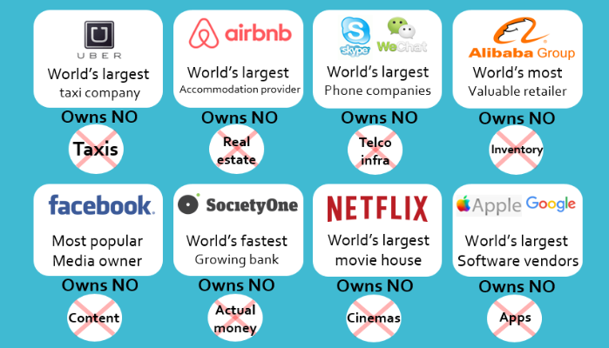
Image: www.bullhorn.com/blog/2016/06/digital-disruption-consulting/

Slide 11
How we conceptualise ‘disruption’
‘Disruption’ implies problems
  Troubles that need to be fixed or solved
  Need to ‘weather the storm’
‘Disruption’ implies that it is a temporary state of affairs
  Things will return to normal
‘Disruption’ implies that it is a minor tremor, rather than a major earthquake

Slide 12
The reality…
Is it temporary?
  The world has changed – and will continue to change – fundamentally
  There is no way to go back to the way things used to be
  Old models and methods of doing business have been superseded
Is it minor?
  This is a paradigm shift: a whole new way of thinking and understanding
  The game has changed
  The balance of power has moved

Slide 13
Digital disruption ‘Digital opportunity’
This is not minor or temporary
But rather than creating problems, it is creating exciting opportunities
and solutions for all industries
Increasing efficiencies
Improving access to customers
Speeding up communication
Opening up new markets
Reinvigorating existing markets
….

Slide 14
Opportunity for the workforce of the future*
82% of business leaders expect their organisations to be a digital business within
3 years (Accenture, 2015)
If they are going to realise the benefits they anticipate from being a digital business, then the readiness of the workforce must be a priority
Today’s employers expect graduates to have well-developed digital capabilities
  To hit the ground running in a new job
  To act as change agents within the organisation
A number of studies examine the impact of rapid technological change and
new business models on employment in Australia:
  Business Council of Australia
  Australian Council of Learning Academics
  CSIRO
  Regional Australia Institute and NBN
* And the future starts now…

Slide 15
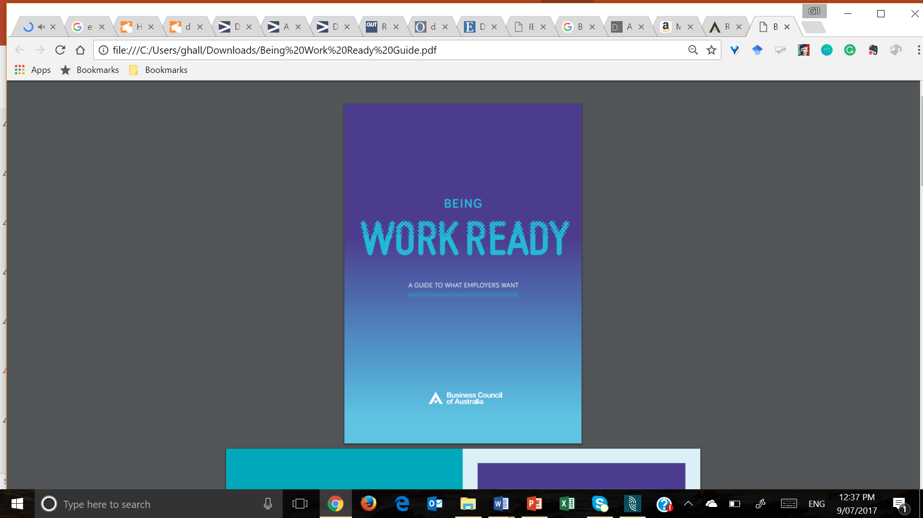
Business Council of Australia
Being work ready: A guide to what employers want
Technical skills
Understanding of ICTs
Data analysis
Critical analysis
All contextualised for the immediate work roles

Slide 16
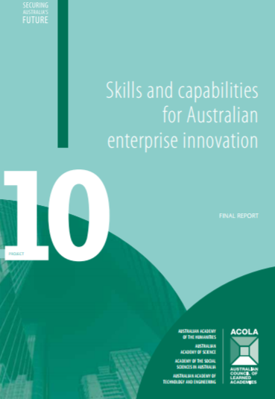
Australian Council of Learning Academics (ACOLA)
Skills and capabilities for Australian enterprise innovation
National project to examine the capabilities
  To foster and support innovation
  To generate new ideas
Multidisciplinary: HASS + STEM
Employees need to be able to
“think in technological terms and know
what and how solutions can be achieved
through the use of technology”
Digital literacy
Design thinking
Collaboration and teamwork
Problem solving

Slide 17
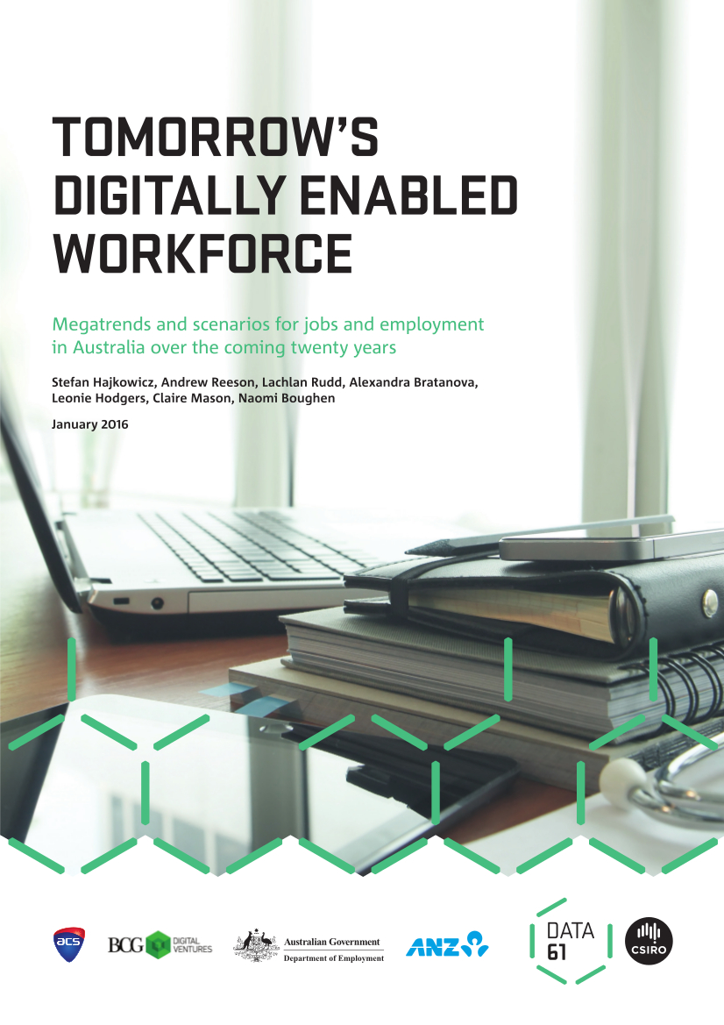
CSIRO
Tomorrow’s digitally enabled workforce:
Megatrends and scenarios for jobs and employment
in Australia over the coming twenty years
The report reviews a number of megatrends
  Computing speed
  Data volumes
  Device connectivity
How can technology augment the value
of human enterprise?
Disciplinary and professional boundaries blurring
Potential for new creative work roles

Slide 18
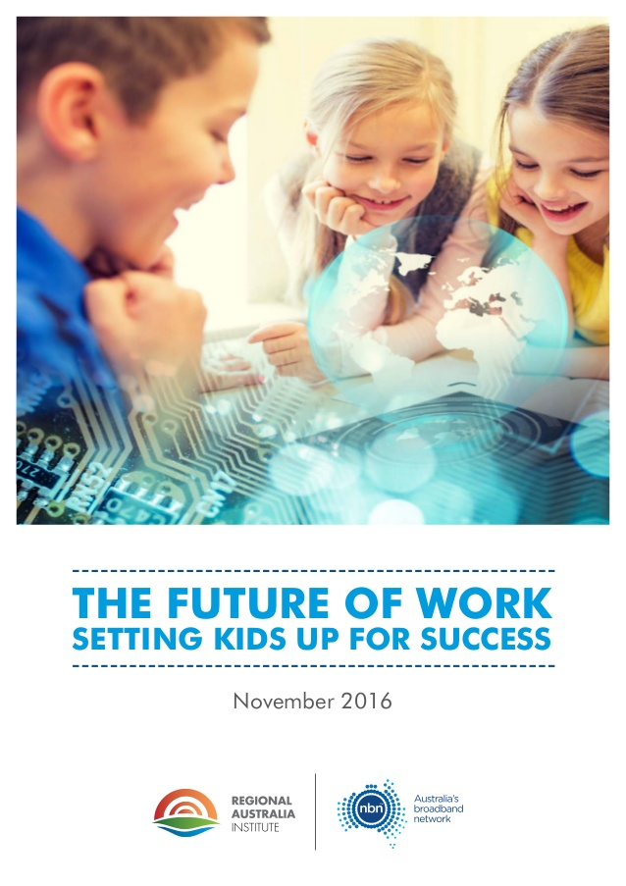
Regional Australia Institute & NBN
The future of work: setting kids up for success
Within 2-5 years, 90% of the workforce
will require basic digital literacy
The need to use technology
“purposefully and confidently”
50% will need higher technology skills
  Programming
  Software development
Information, digital and media fluency
will be absolutely critical

Slide 19
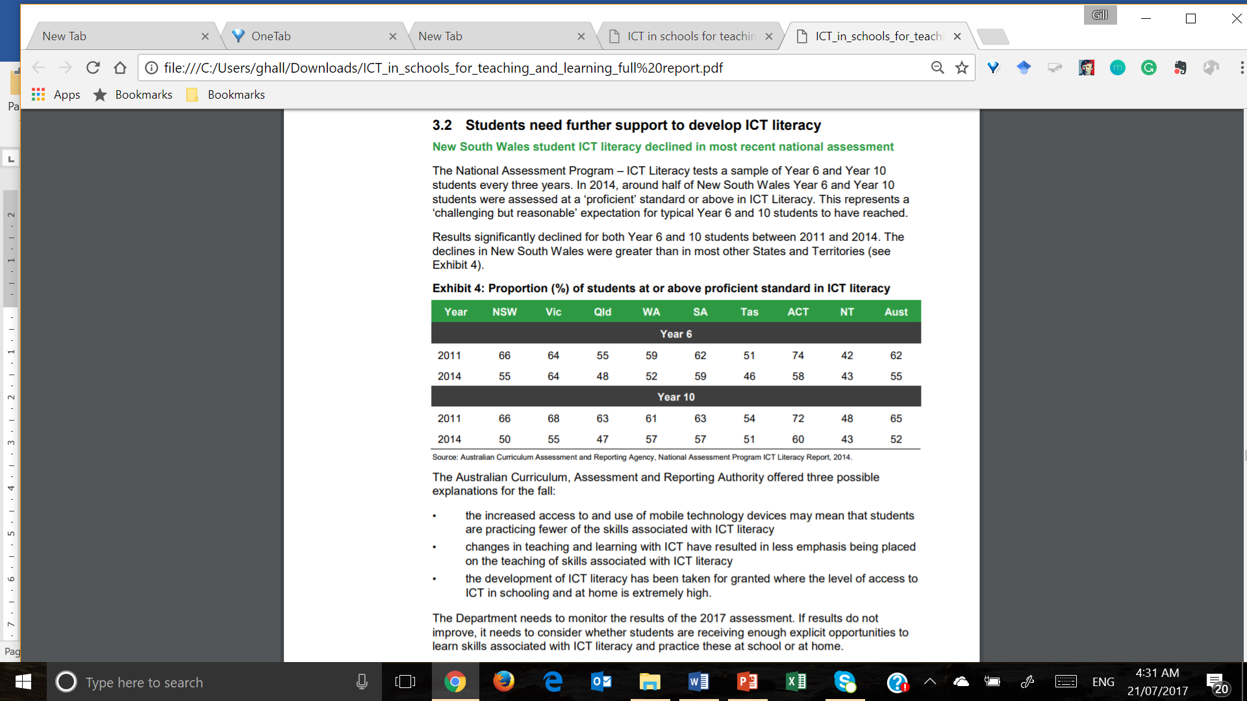
(NSW Audit Office, 2017)

Slide 20
Proportion (%) of students at or above proficient standard in ICT literacy

Slide 21
Where does the higher education sector fit it?
To date, the education sector has been pretty stable
… Lectures > Assignments > Tests and exams …
Argument that the system produces students to meet government guidelines – and it does that well
However, how well is the education sector contributing to the workforce that is needed to meet the digital opportunities?
“The bigger issue is that it’s not producing people to take on jobs” (Reilly, cited in Buckley, 2015)
Graduate unemployability is a concern: there is a disconnect between:
  What industry wants
  What is coming out of some universities

Slide 22
How is digital technology having an impact on education?
Learning has always been a social activity [read ‘social constructivism’]
Technology allows and supports new approaches to [social] learning activities
The academic is no longer ‘the keeper of knowledge’
  Content is ubiquitous
  Knowledge is more democratic and accessible
  Now a facilitator, an integrator of knowledge
  Creating more personalised conditions to help students learn
Students want to learn in new ways
  Online access
  Flipped classrooms
  Gamification
  Virtual reality

Slide 23
Digital opportunities in education
Online classrooms make high-quality education available to more people
Mobility enables learning anytime, anywhere
Web-based learning facilitates more frequent, flexible interaction between
students and academics
Social media help to build collaborative communities, increasing participation and encouraging debate
Blended learning provides pedagogical variety
Technology enables collaboration, co-curation and co-creation of knowledge
Analytics can help build academics’ and students’ understanding of ‘learning’
The importance of enhancing the student experience

Slide 24
But -- disruption?
Is the degree really worth the investment??
MOOCs
  Coursera, edX, Udacity, Khan Academy
YouTube education channels
Badges, micro credentials
Academic learning support: personalised tutoring delivered online
  cf the large class sizes at university
  Sometimes funded by the university itself
PWC (and others) has ditched the need for discipline-specific qualifications
  Looking at a broad base of degrees and experience

Slide 25
New models for learning
DeakinDigital: professional practice degrees in IT and financial planning
  Work experience counts: credit can be gained over 12 areas:
    Self-management, teamwork, communication, innovation, emotional judgement, problem solving, cultural engagement, innovation, global citizenship, critical thinking, innovation, digital literacy
  Expertise in 10 of the 12 areas can contribute to two thirds of credit for a degree
  Cost is one third of a traditional Masters degree
Glynn Davis (Uni of Melbourne): the university as the curation of learning
  No actual ‘teaching’
  Guiding students through a series of online options around
  a set of degree goals
PeoplePlan: a platform to put a value on the learning obtained
from an online source, eg YouTube, newspapers etc

Slide 26
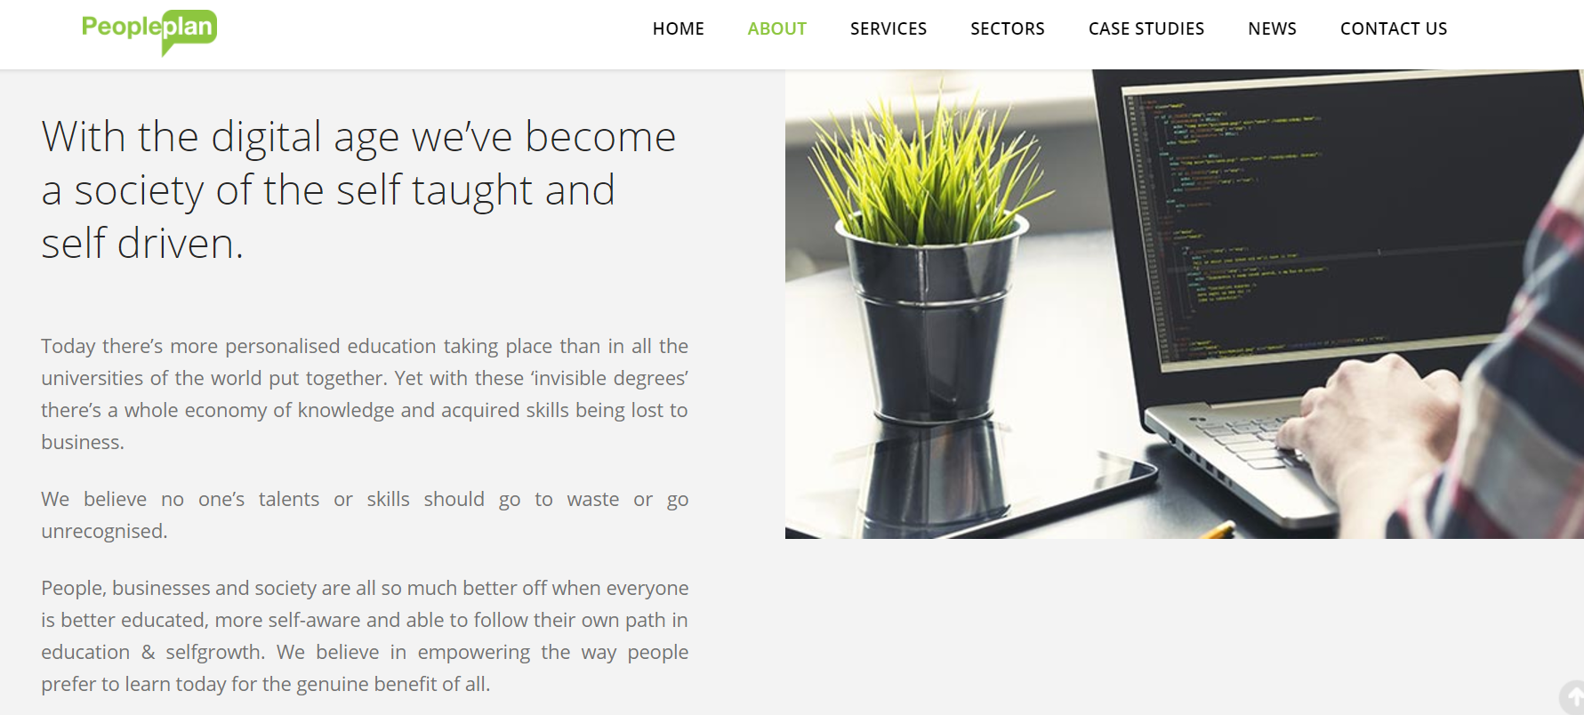

Slide 27
Opportunities to develop the digital learning experience
Students want high performing technology in their educational (and administration) experience which reflects the connectivity in their daily lives
  80% stated that digital capabilities were important when deciding which university to go to
  70% want more use of digital tools, inside and outside the classroom
  81% want more integration of technology into the classroom experience
  44% said their university provided no digital tools for learning
Need to:
  Embrace the digital realities into the existing culture
  Implement a digital mindset
  Offer a learning environment with multiple channels for different content
  Encourage:
    Career support
    Lifelong learning opportunities
    Engagement through digital media
The importance of the student experience
(Accenture, 2014)

Slide 28
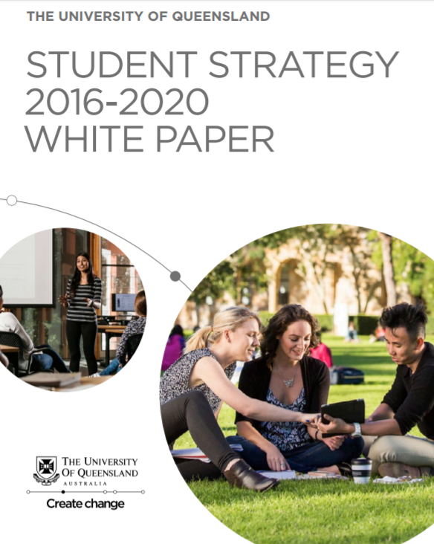

Slide 29
The UQ Student Strategy
“ | Digital technologies have fundamentally altered the way we live and work. They have broken down barriers and given rise to a wave of new job titles, a growing virtual workforce and an explosion in personalized online services – all of which are having a profound impact on what and how we choose to learn.

Slide 30
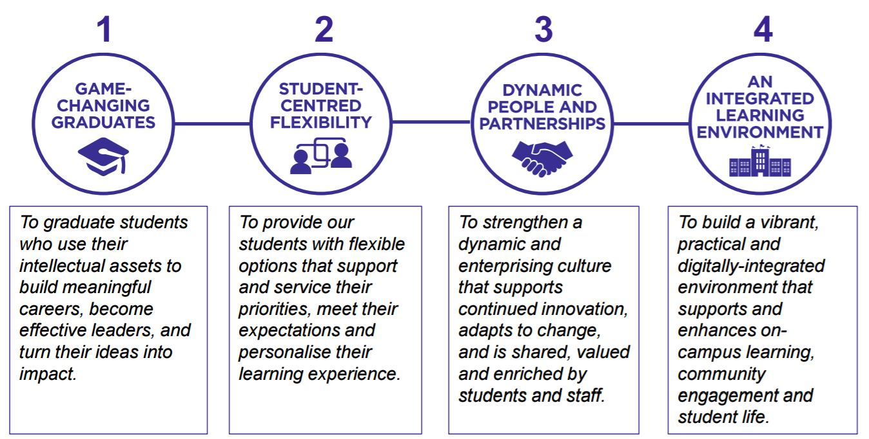
Key strategies

Slide 31
The role of UQ Library
“ | Library staff will strengthen the Library’s role as an essential partner in research, teaching and scholarly communication. This will be through engagement and collaboration with all levels of the UQ community, at multiple points in their research, teaching, learning and publishing. In doing so, we will ensure that the Library supports the University’s strategic directions.
(UQL Strategic Plan 2013-2017)

Slide 32
The strategic value of information & digital literacy
NMC Horizon Reports
  Watching brief on digital literacies over the years
  Tracking the shift from one-way learning activities to collaborative content creation
  Potential to improve digital literacy viewed as a “solvable challenge” (Adams Becker, 2017a, 2017b)
Recent research-focused projects relating to digital literacies in the academic world
  European Union, UNESCO, OECD
  JISC: a number of funded projects, eg LLiDA (Glasgow), PriDE (Bath), The Digital Department (UCL)
  Leeds Metropolitan University, London School of Economics, the Open University
Practical activities
  Deakin University, La Trobe University, University of Adelaide
Research activities
  Jo Coldwell-Neilson, OLT Fellow
  “Fellowship will build a shared understanding of digital literacy. It will develop a digital literacy benchmark for students entering and graduating from Australian higher education (HE) institutions, bridging the gap between school skills (as defined by the Australian National Curriculum) and workplace skills (as demanded by employers)”

Slide 33
Opportunities to build digital capabilities
Digital technologies create new opportunities for the collaborative
co-construction of knowledge
The active processes of managing, synthesising and re-purposing data
and information are highly valued
We need a clear understanding of how the ways that students and researchers think, interpret and communicate ideas are influenced by their interactions with digital information resources
However – real concerns about a patchwork pattern of information and digital literacy skills
“A university-wide approach… which attempts to involve all faculty and students” is recommended
(Alexander et al, 2016, p.11)

Slide 34
Information and digital literacy to support the UQ community
The vision:
All members of the UQ community will develop the
information and digital literacy skills they need to
thrive and lead throughout their personal, academic, professional and civic lives

Slide 35
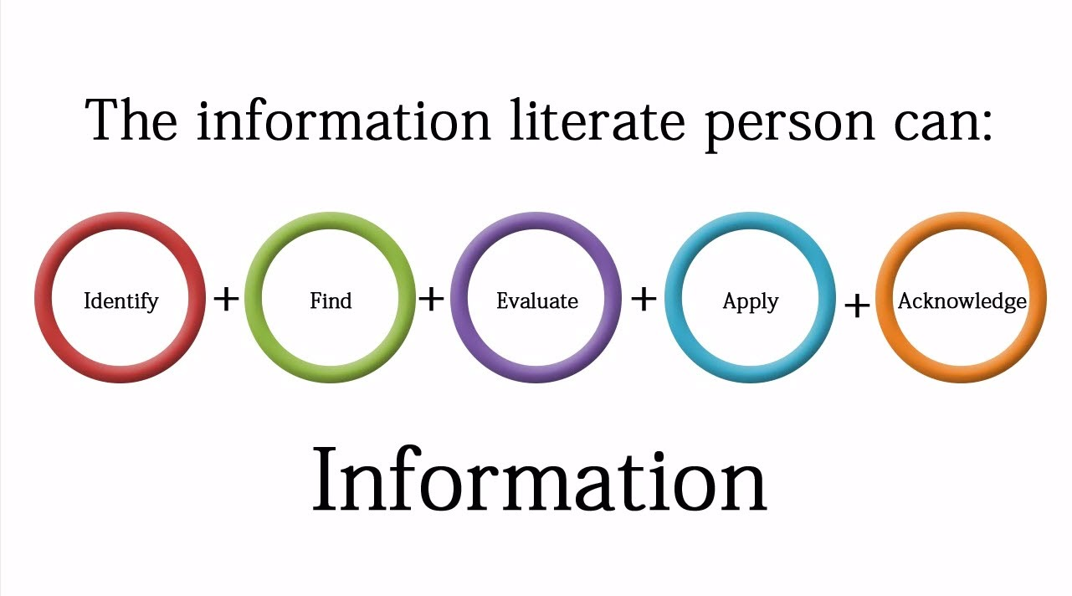
Our changing understanding of ‘information literacy’
2000 Association of College and Research Libraries (ACRL): Information Literacy Standards
2004 Australian and New Zealand Information Literacy Framework
Image: www.melangeinfo.com

Slide 36


















Slide 37
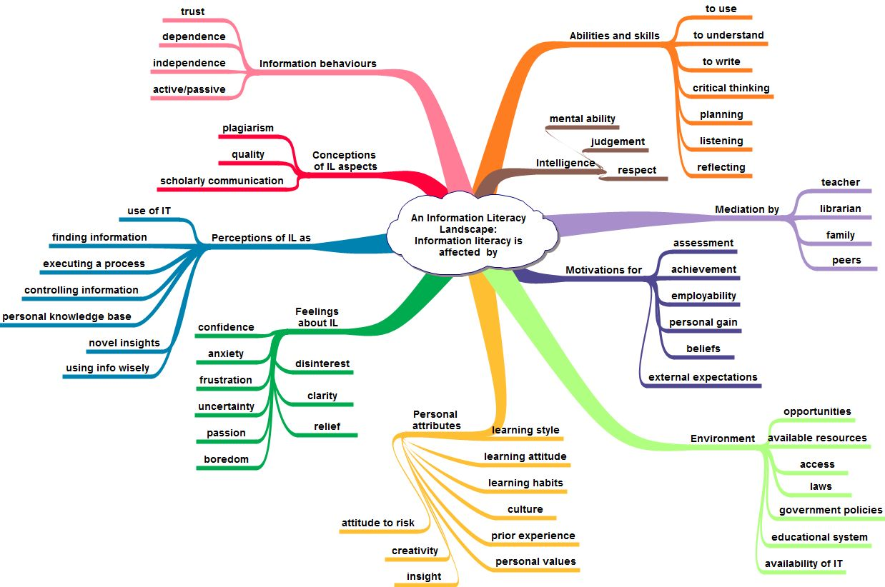
Cognitive elements
Image: Moira Bent

Slide 38
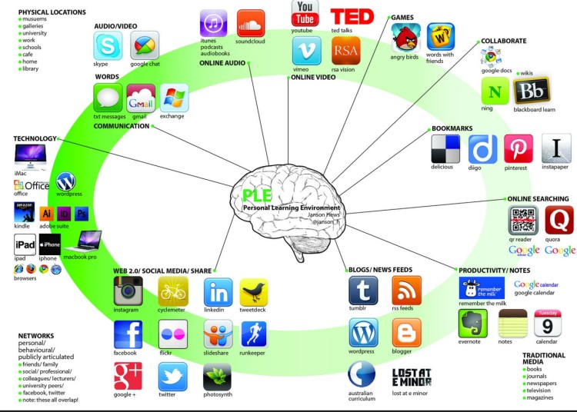
Learning environment
Image: Janson Hews

Slide 39
The central issues
Digital literacies represent the capabilities which fit a person for living, learning and working in a digital society (JISC, 2015)
The UQ Student Strategy emphasises the impact of digital technologies on life
Employers expect graduates to have well-developed digital capabilities to hit the ground running, and to act as change agents
Universities have the responsibility to develop students who can thrive in the digital world

Slide 40
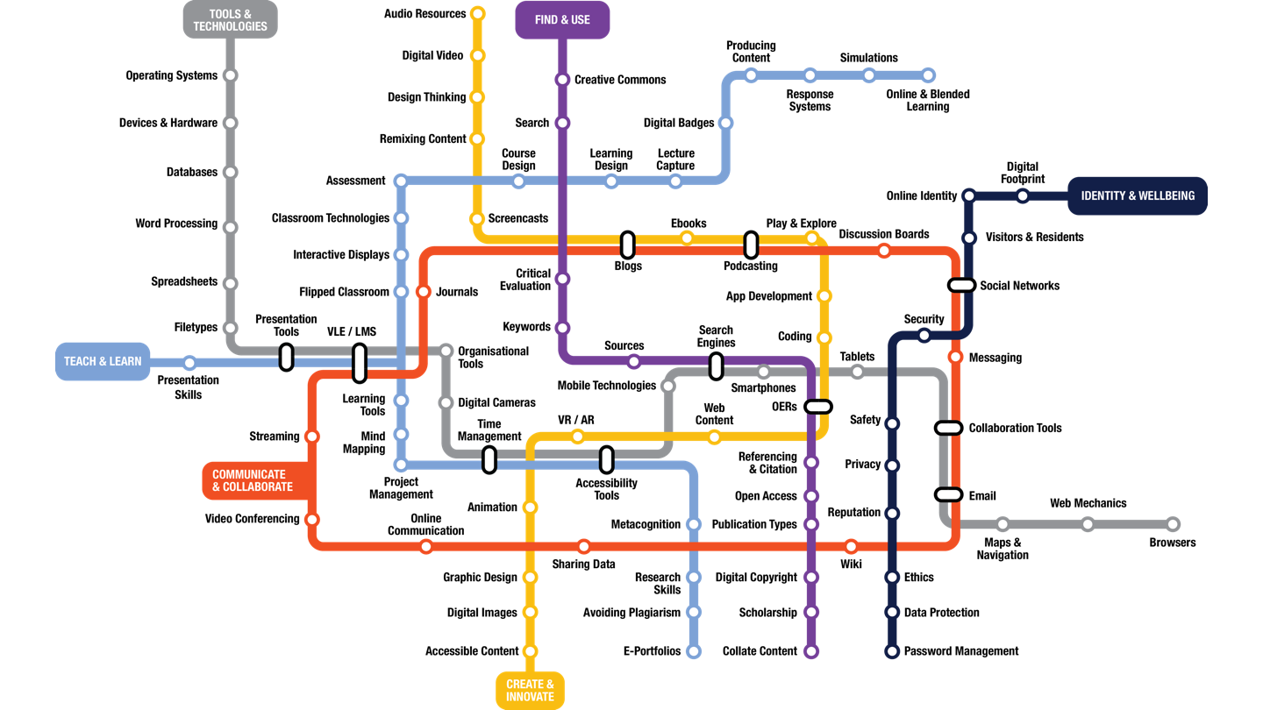
Image: allaboardhe.ie

Slide 41








In different disciplines and professions?
Icons from thenounproject.com

Slide 42
Are there some common denominators?
Are there some common, foundational elements of ‘digital literacy’?
Is it possible to identify these and distil them into a model or framework?
Can a model be used to guide the development of skills across the different disciplines?

Slide 43
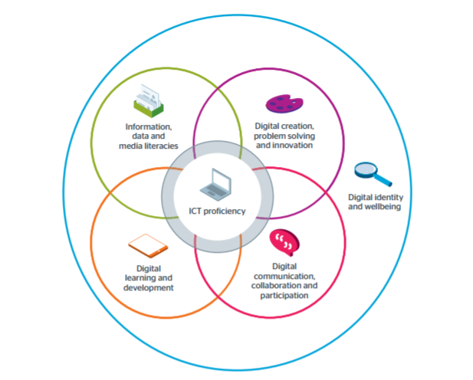
(JISC, 2017)

Slide 44
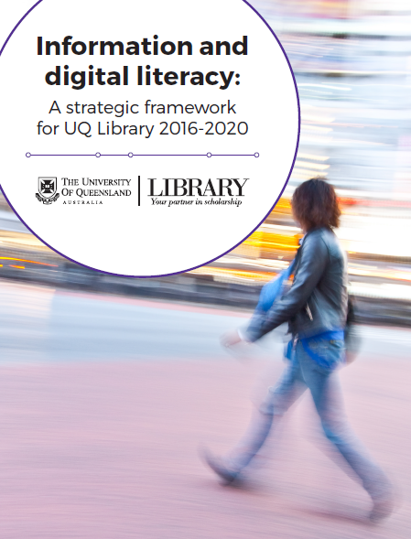
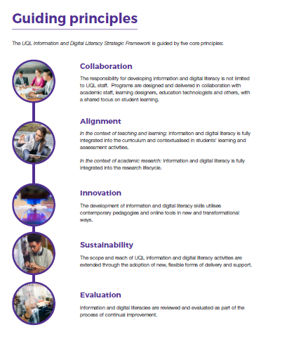

Slide 45
Current initiatives at UQ Library
Collaboration
  eLearning co-located with IDL team
  Online learning resources: ITaLI, Graduate School, Student Services, faculty librarians
  T&L grant to investigate students’ IDL skills gaps and provide strategies to build skills
  Sharing practice and ideas across the Library, across the university
Alignment
  Mapping librarians’ IDL activities across all courses and programs
  T&L grant proposal to focus on the contextual differences across the disciplines
Innovation
  Digital librarians-in-residence
  Poster Fairs to showcase impact of IDL activities on T&L at UQ
Sustainability
  Extending the reach of IDL development – strategic funding to move into digital content
  New training activities for students and academic staff
Evaluation
  Review and feedback

Slide 46
IDL to foster digital scholarship
Digital scholarship is evolving as new technologies allow researchers to engage
with content
  Both traditional physical and increasingly digital
  Born digital or digitised
To expose and explain previously unseen patterns to create new knowledge
All about how students’ and researchers’ interactions with digital information resources influence the ways they think, interpret and communicate ideas
Digital humanities allow closer connections between research and teaching, enabling students
  To engage with original materials
  To adapt and repurpose content for new creative works
  To build new skill sets
IDL becomes the new foundation for both learning and research activities

Slide 47
Centre for Digital Scholarship (CDS):
Digital infrastructure, digital tools, digital training
CDS provides a space for academics and students, across all disciplines, enrolment status and employment roles, with resources, services and support for digital scholarship activities
Supporting the shift from ‘independent’ research to ‘collaborative and participative’ research
Opportunities to facilitate and establish networks and communities of users
  To bring together experienced users and potential new players
  To showcase and to learn in a collaborative or mentoring way
Provides access to hardware and software tools:
  3D printing and 3D photogrammetry
  Geographic Information Systems
  Web scraping, text mining and textual analysis
  Data analysis, interpretation and visualisation
Staffed by casual staff who are (usually) HRD students
  Enhancing the student experience and increasing employability
Liaison librarians building cohesion between the Schools and CDS

Slide 48
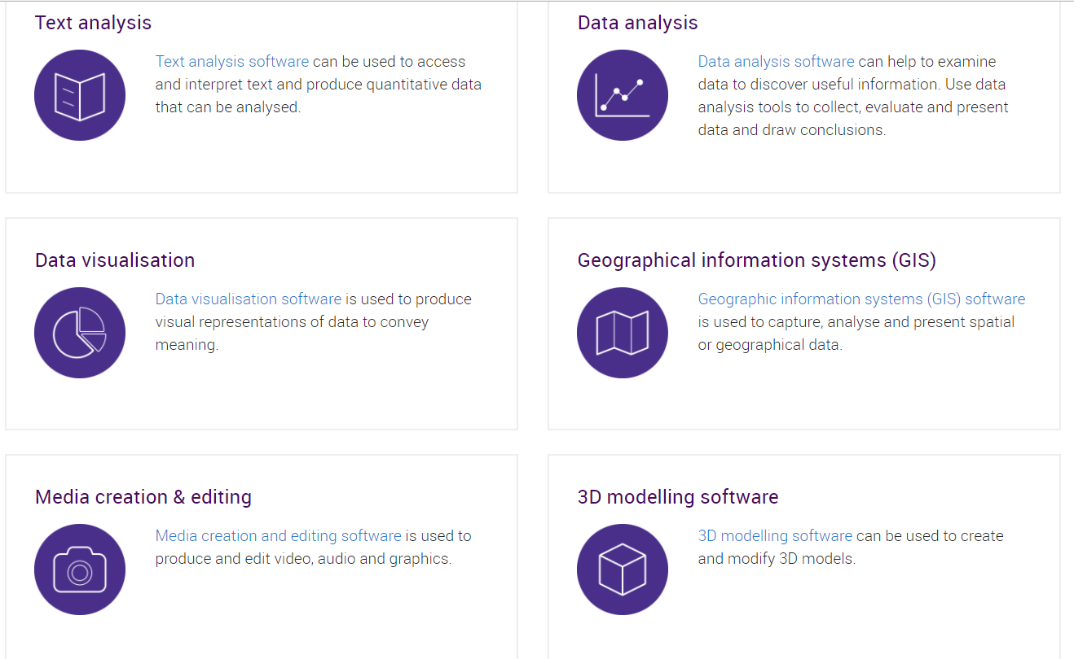
CDS website

Slide 49
A university-wide approach is needed
  To align the Library with the institution’s strategic directions
  To provide opportunities to build and demonstrate excellence and
  impact across learning, research and digital scholarship
The IDL Strategic Framework is
  A conversation starter to facilitate:
    A common language
    A shared philosophy
  A document to help the Library:
    To demonstrate the roles it plays in supporting learning and research
    To align itself with the ICT agenda across the institution
    To articulate its investments in online systems and e-content
    To open up opportunities for new ideas, new collaborations
    To encourage the library staff to develop new skills and understandings
Building a successful future through information and digital literacy

Slide 50
References
Accenture Strategy (2015). Digital disruption: Embrace the future of work and your people will embrace it with you. https://www.accenture.com/t00010101T000000__w__/au-en/_acnmedia/PDF-4/Accenture-Strategy-Digital-Workforce-Future-of-Work.pdf#zoom=50
Adams Becker et al (2017a). NMC Horizon report: 2017 higher education edition. www.nmc.org/publication/nmc-horizon-report-2017-higher-education-edition/
Adams Becker et al (2017b). NMC Horizon report: 2017 library edition. https://www.nmc.org/publication/nmc-horizon-report-2017-library-edition/
Alexander, B., Adams Becker, S. & Cummins, M. (2016). Digital literacy: An NMC Horizon Project strategic brief. www.nmc.or/publication/digital-literacy-an-nmc-horizon-project-strategic-brief
Association of College and Research Libraries (ACRL) (2000). Information literacy competency standards for higher education. http://www.ala.org/acrl/standards/informationliteracycompetency
Association of College and Research Libraries (ACRL) (2015). Framework for information literacy in higher education. www.ala.org/acrl/standards/ilframework
Australian Council of Learning Academics (ACOLA) (2016). Skills and capabilities for Australian enterprise innovation. http://acola.org.au/wp/PDF/SAF10/Full%20report.pdf
Buckley, R. (2015). Why the education sector is ripe for disruption. Global Intelligence for the CIO. January 2015.
http://www.i-cio.com/management/insight/item/why-education-sector-is-ripe-for-digital-disruption
Bundy, A. (2004). Australian and New Zealand Information Literacy Framework: Principles, standards and practice. 2nd ed. Adelaide: ANZIIL. www.caul.edu.au/caul-programs/information-literacy/publications
Business Council of Australia (2016). Being work ready: A guide to what employers want.
www.bca.com.au/publications/being-work-ready-a-guide-to-what-employers-want
Christensen, C. (1995). Disruptive technologies: Catching the wave. HBR, 73(1), 43-53.
CSIRO (2016). Tomorrow’s digitally enabled workforce. https://www.data61.csiro.au/en/Our-Work/Future-Cities/Planning-sustainable-infrastructure/Tomorrows-Digitally-Enabled-Workforce

Slide 51
Evans, N. (2017). Mastering digital business. London: British Computer Society. See also: Evans, N. (2017). Assessing your organisation’s digital transformation maturity.
https://disruptionhub.com/digital-transformation-maturity/
Jisc (2017). Building digital capabilities: The six elements defined. http://repository.jisc.ac.uk/6611/1/JFL0066F_DIGIGAP_MOD_IND_FRAME.PDF
Kelly, K. & Schaufenbuel (2016). Preparing business leaders for digital disruption.
http://www.kenan-flagler.unc.edu/~/media/Files/documents/executive-development/unc-white-paper-preparing-business-leaders-for-digital-disruption.pdf
NSW Audit Office (2017). ICT in schools for teaching and learning.
https://www.audit.nsw.gov.au/publications/latest-reports/ict-in-schools-for-teaching-and-learning
Perrett, R. (2017). Digital disruption: Data intelligence, digital supply chain and beyond. https://www.ibm.com/information-technology/digital-disruption-data-intelligence-digital-supply-chain-and-beyond
Regional Australia Institute & NBN (2016). The future of work: Setting kids up for success. http://www.regionalaustralia.org.au/home/wp-content/uploads/2016/11/The-Future-of-Work_report.pdf
The Royal Society (2012). Science as an open enterprise. The Royal Society Science Policy Centre report 02/12. https://royalsociety.org/~/media/policy/projects/sape/2012-06-20-saoe.pdf
University of Queensland (2013). Strategic plan 2013-2017. www.uq.edu.au/about/docs/strategicplan/StrategicPlan2013.pdf
University of Queensland Library (2013). Strategic plan 2013-2017. https://web.library.uq.edu.au/files/28/filename.pdf
University of Queensland Library (2016). Information and digital literacy: A strategic framework for UQ Library 2016-2020. https://web.library.uq.edu.au/files/14363/UQL_IDL_StategicFramework.pdf

Slide 52
Contact:
Gillian Hallam g.hallam@library.uq.edu.au

